Slide 1
STRANDED GAME PROJECT
By: Patrice Williams, Asadullah Anfishi, Sirine Charkaui and Sabrine Charkaui

Slide 2
TABLE OF CONTENTS
1. INTRODUCTION
4. DEMONSTRATION
2. PLANNING / DESIGN
5. EVALUATION
3. DEVELOPMENT
6. QUESTIONS

Slide 3
INTRODUCTION

Slide 4
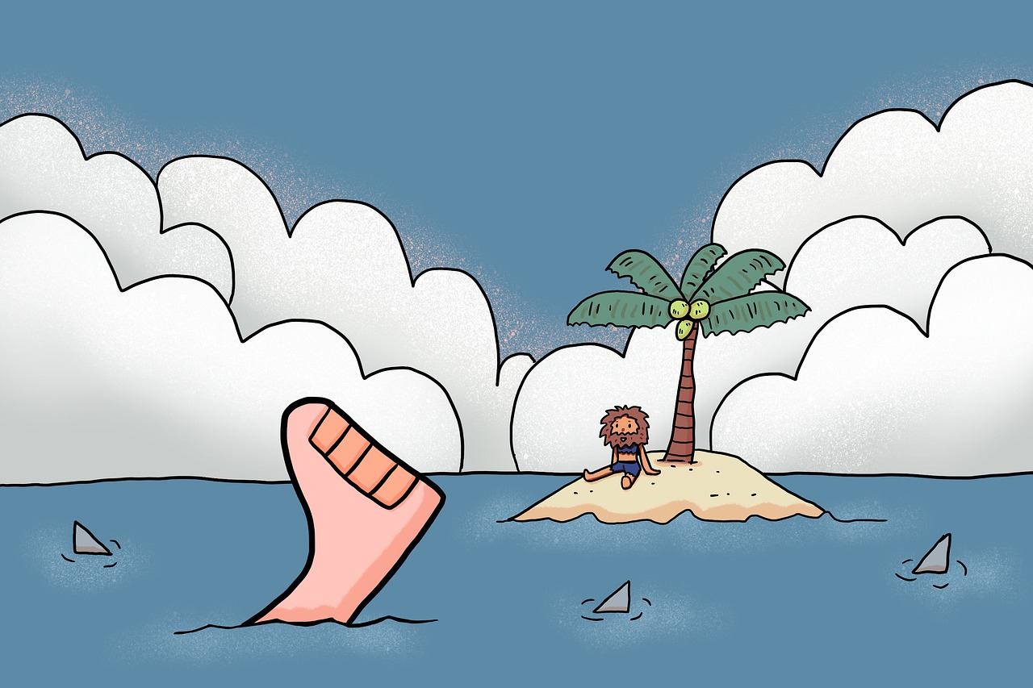
STORYLINE

Slide 5
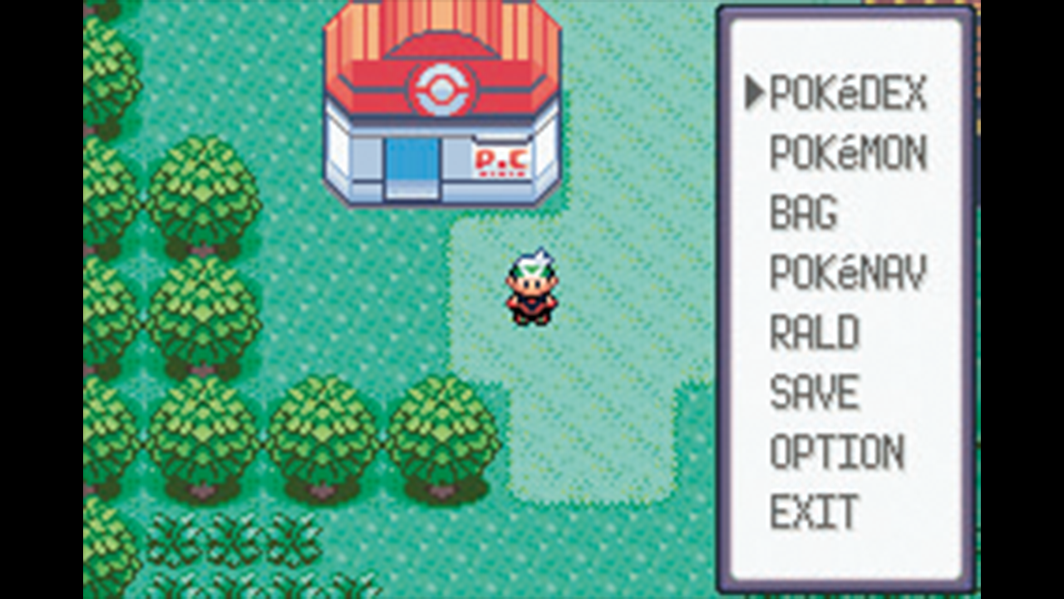
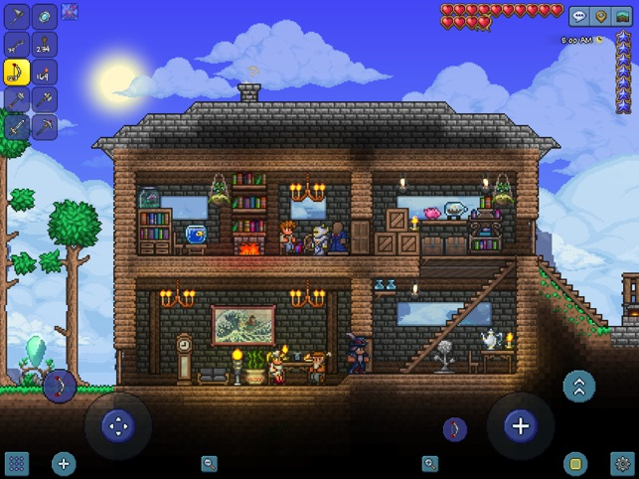
GAME DETAILS
Game Name: STRANDED
Genre: Survival, Single-player
Theme: Island
Projection: Top-down
Framework: Unity 2D
Programming Language: C#
Code IDE: Visual Studio Code
Controls: Mouse & Keyboard
Inspiration
Notes:
Pokemon Ruby (Game Boy Advance)
Terraria

Slide 6
REQUIREMENTS
Character Attribute: Health
Character movement in four directions - player input
Attack enemies and animals when in close range
Take damage from enemies
When character health is zero - character dies
Pick up and store food
Health increase from eating food
Opposition: Tribe people
Enemy movement in four directions - follow character when in range
Attack character when in close range
Take damage from character when attacked
When enemy health is zero - enemy dies
Storage: Food from animals
Animals movement in four directions - change direction every so often
Take damage from character when attacked
When animal health is zero - animal dies and drops food
Food increases character health when eaten
Goal: Survive and Escape
Character has to try and not die from enemies
Character has to kill the boss (tribe leader)
Character has to get on to the boat to escape the island

Slide 7
PLANNING / DESIGN

Slide 8


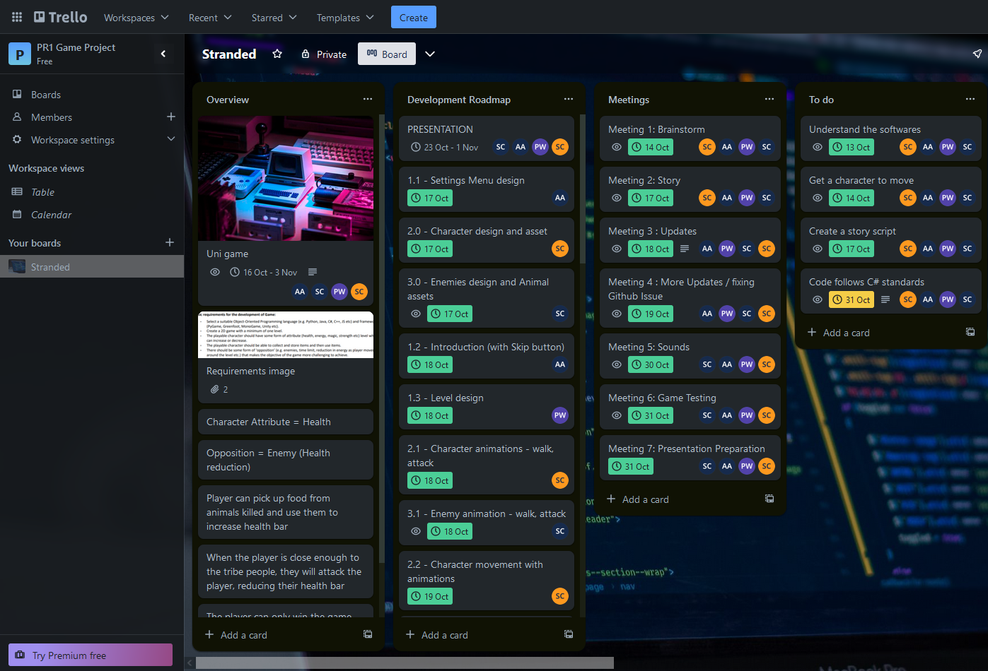
PLANNING

Slide 9
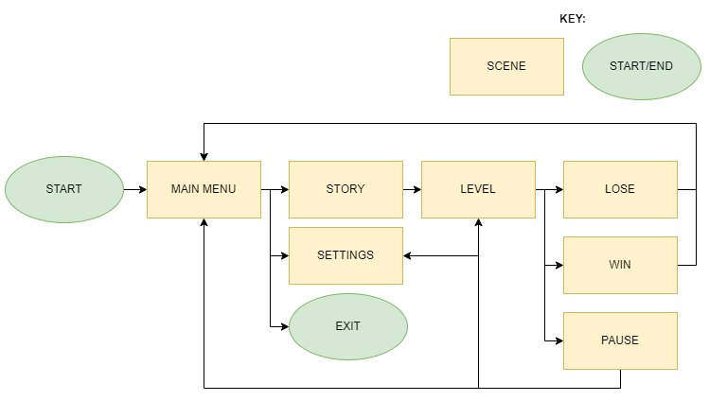
SCENE SEQUENCE

Slide 10
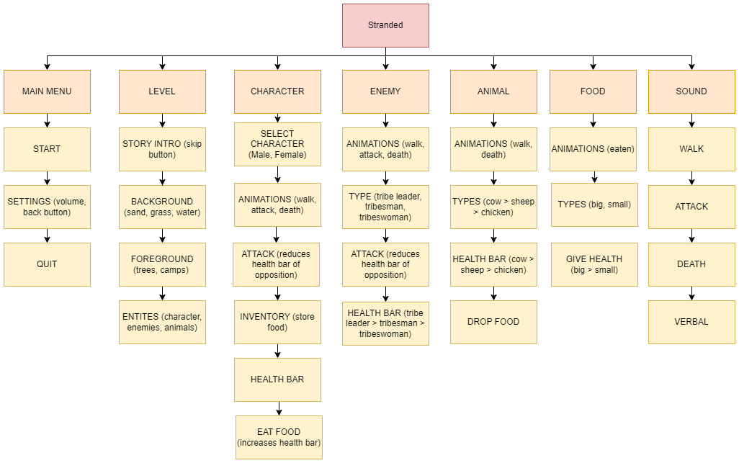
GAME BREAKDOWN

Slide 11
DEVELOPMENT

Slide 12


DEVELOPMENT
Patrice: Lead Designer, Programmer and Sound Engineer
Asadullah: Project Manager, Lead Programmer and Tester
Sirine: Animator, Programmer and Documenter
Sabrine: Designer, Animator and Programmer
Notes:
Patrice
Level design
Entity positions
Entity borders
Death screen
Ending screen
Sound effects
Asadullah
Menu
Story scenes
Animal death with food
Character inventory functionality
Health bar increase
Pause screen
Character select
Sirine
Character design
Character animations
Character movement
Character health bar
Character attack
Character inventory design
Health bar decrease
Map borders
Sabrine
Enemy designs
Enemy animations
Enemy movement
Enemy health bars
Enemy attack
Animal animations
Animal movement
Animal health bars

Slide 13
DEVELOPMENT ROADMAP
OCTOBER 16
OCTOBER 30
OCTOBER 21
OCTOBER 18
OCTOBER 26
Pause, Death, Ending screens
Animal death with food
Character inventory
Health bar increase/decrease
Character animations
Enemy animations
Animal animations
Story scenes
START PROJECT:
Main menu
Level design
Character design
Enemy designs
Character movement
Enemy movement
Animal movement
Entity positions
Entity borders
Map border
FINISH PROJECT:
Sound effects
Character select
Beta testing

Slide 14
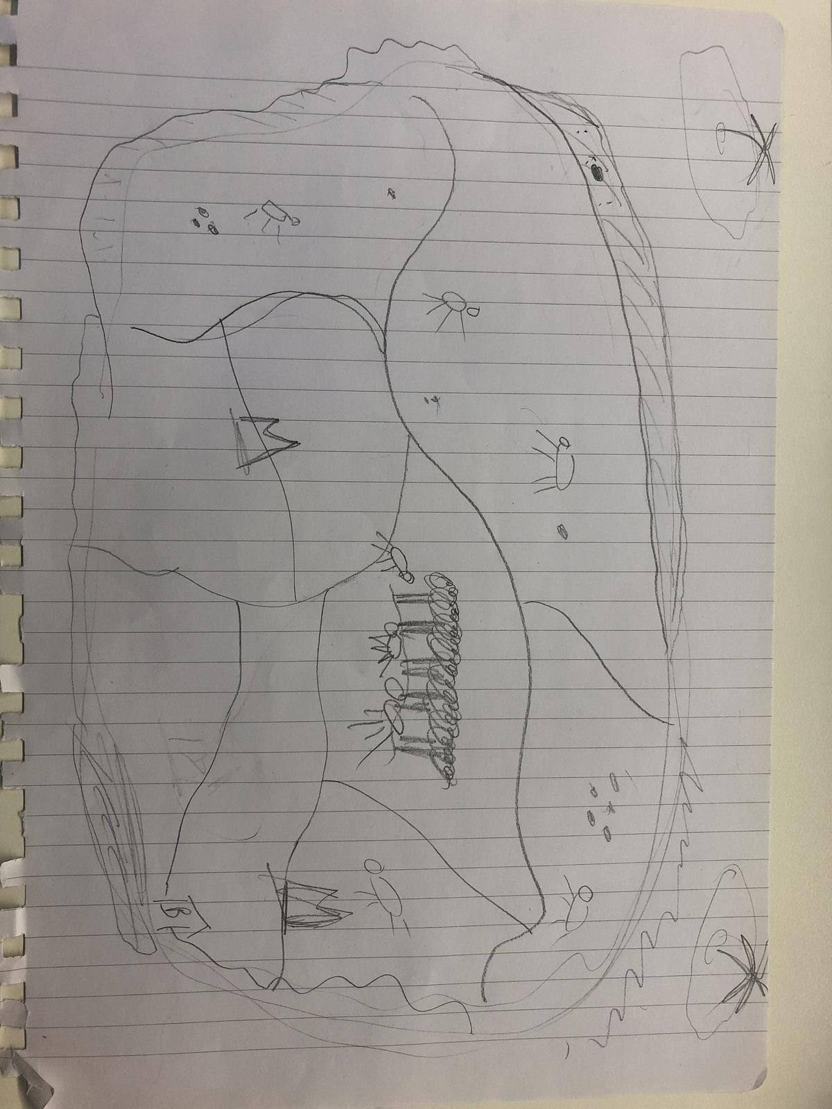
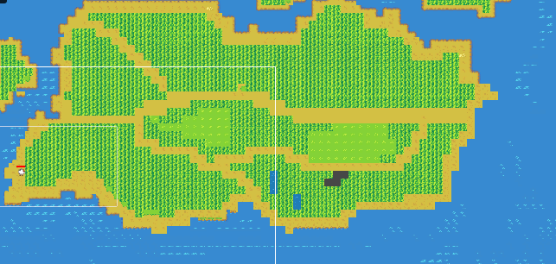
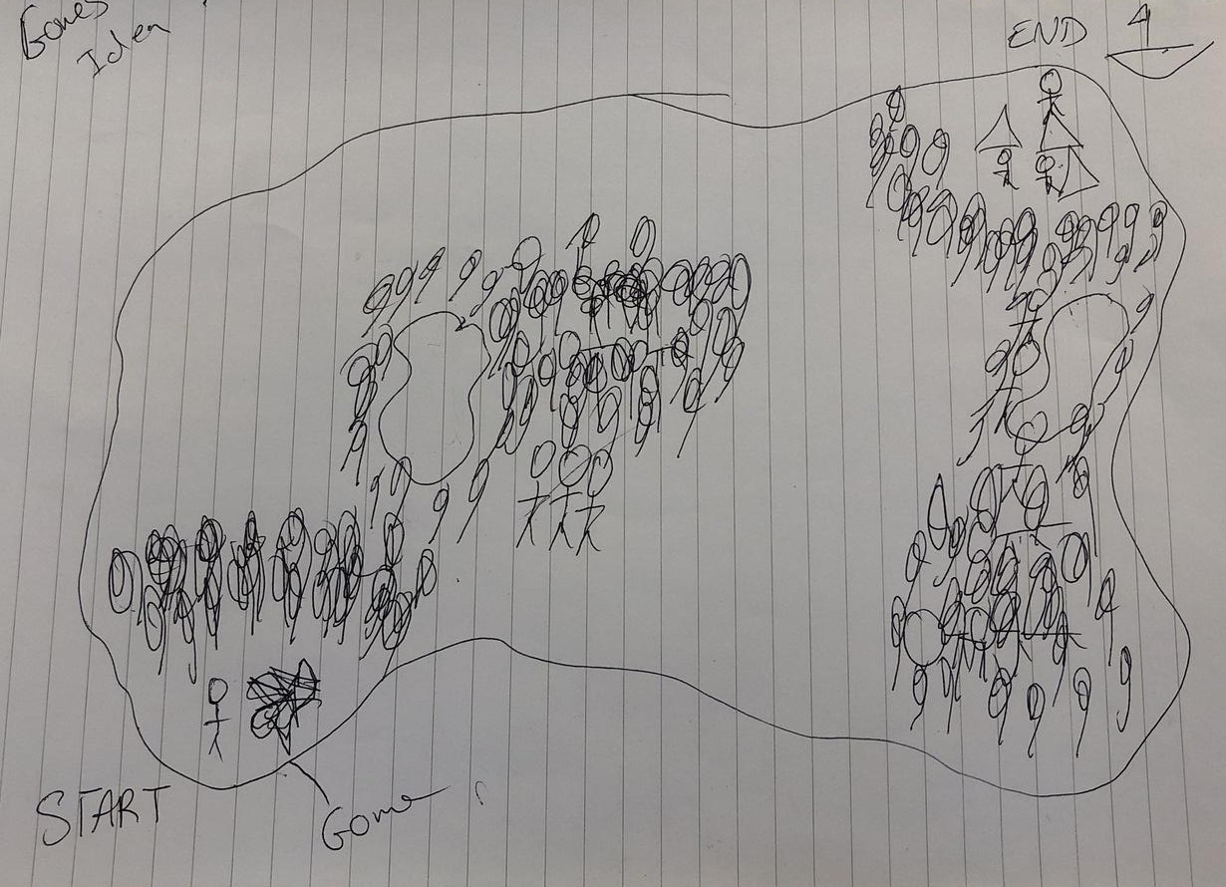
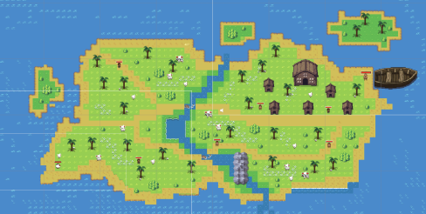
MAP DEVELOPMENT

Slide 15
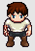
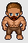
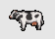
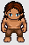

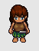
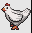
GAME VISUALS

Slide 16
DEMONSTRATION

Slide 17

GAME PLAYTHROUGH
Movement: WASD
Attack: F
Pick up / Use item: Left Mouse Click
Pause Game: Esc

Slide 18
EVALUATION

Slide 19
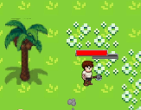
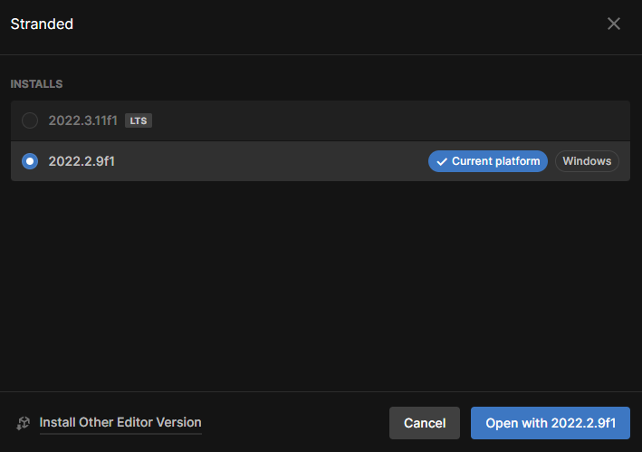
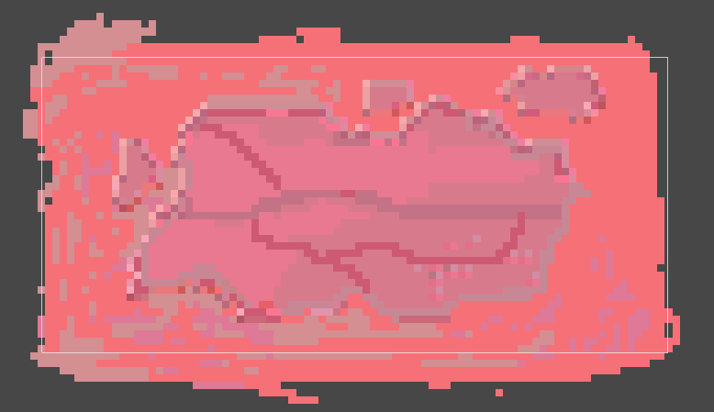
CHALLENGES
Map
Unity editor version
Character inventory
Animal death animations

Slide 20
IMPROVEMENTS
Character selector
Animals death
Sheep dropping food
Character inventory
Background music and Sound effects
Volume slider

Slide 21
REFERENCES
Github Repository:
https://github.com/SabrineC/PR1GameProject
Map Assets:
https://opengameart.org/content/overworld-tiles-0
https://opengameart.org/content/zelda-like-tilesets-and-sprites
Animal Assets:
https://opengameart.org/content/lpc-style-farm-animals
Player/Enemy Designs:
https://sanderfrenken.github.io/Universal-LPC-Spritesheet-Character-Generator/

Slide 22
THANK YOU!
ANY QUESTIONS?

